Slide 1

CS677 Final Project
Hall of Fame Classifier By Tommy Lin

Slide 2
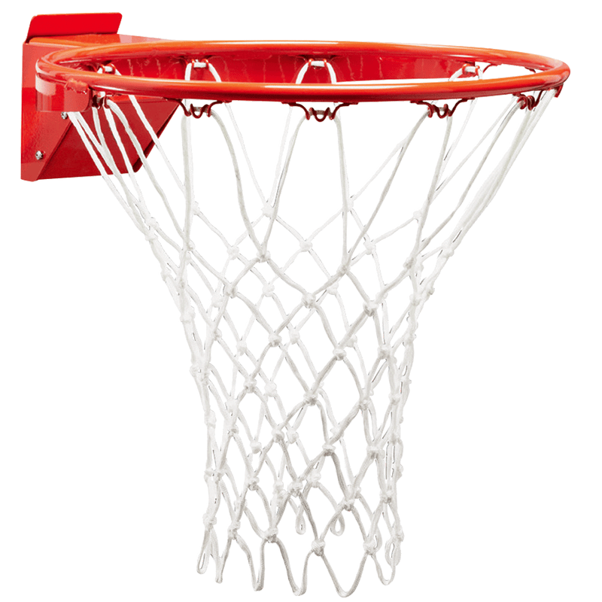
Goals
Figure out what the most important aspects of a basketball career are
Train a classifier that can accurately classify future Hall of Famers
Predict which current players will enter the Hall of Fame

Slide 3
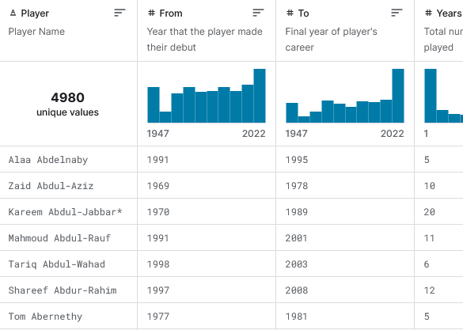
Dataset
“All NBA & ABA Players Bio, Stats, & Accolades”
by Ryan Schubert Last updated June 2022
Contains 4980 players and 39 features

Slide 4
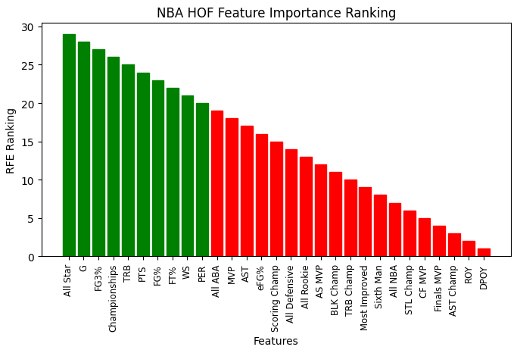
Features
Used RFECV* to select the 10 best features.
Estimator: Decision Tree Scoring: f1
Features: All Star, G, FG3%, Championships, TRB…
*Recursive Feature Eliminator w/ Cross Validation

Slide 5
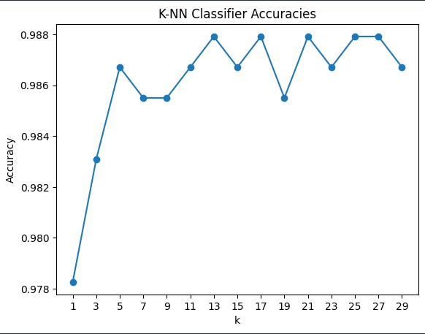
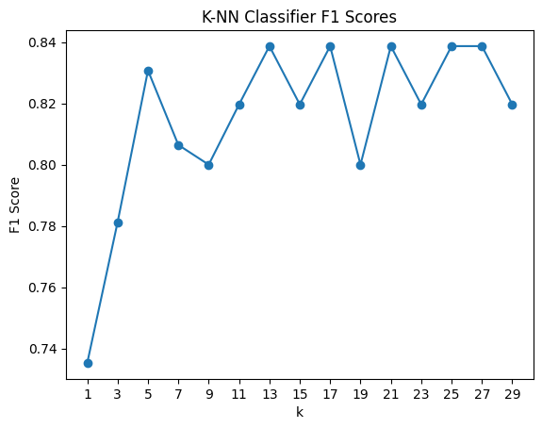
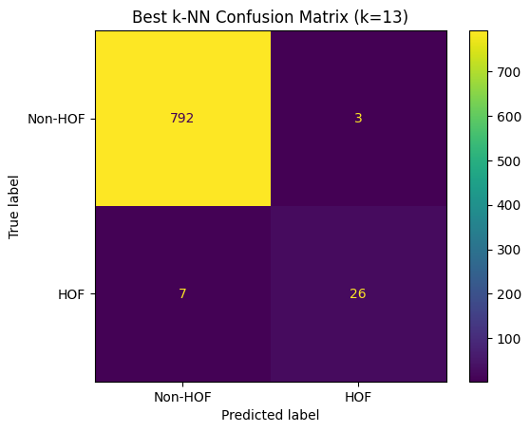
k-NN Classifier
Found that the best k value is 13
Best Accuracy: 0.988 Best F1 Score: 0.839

Slide 6
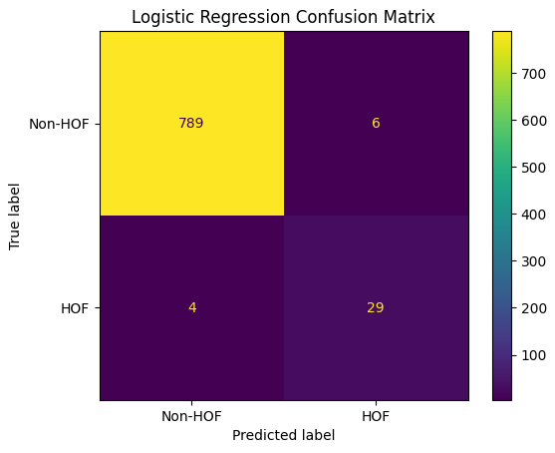
Logistic Regression
Best Accuracy: 0.988 Best F1 Score: 0.853
Same accuracy as the k-NN classifier.
Better F1 score.

Slide 7
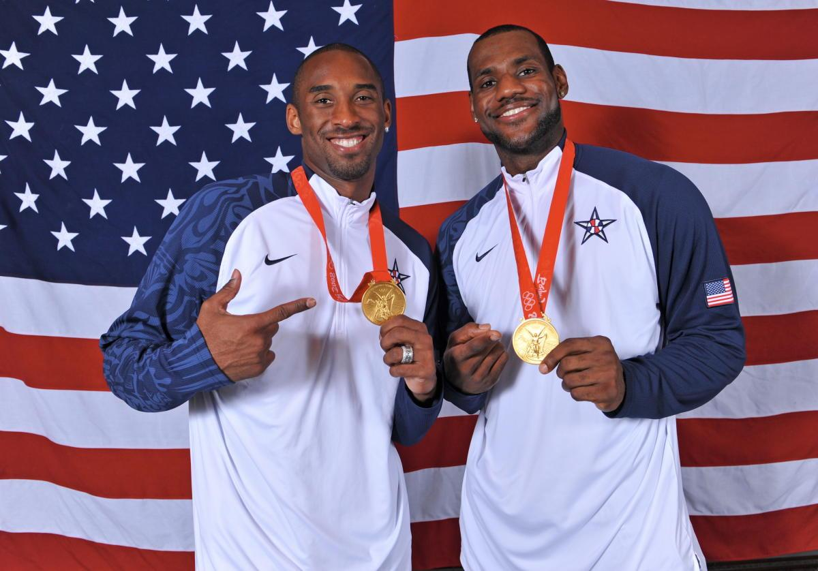

Random Forest (Best)
Best parameters: max_depth=7, n_estimators=25, class_weight=None
Best Accuracy: 0.990 Best F1 Score: 0.875

Slide 8
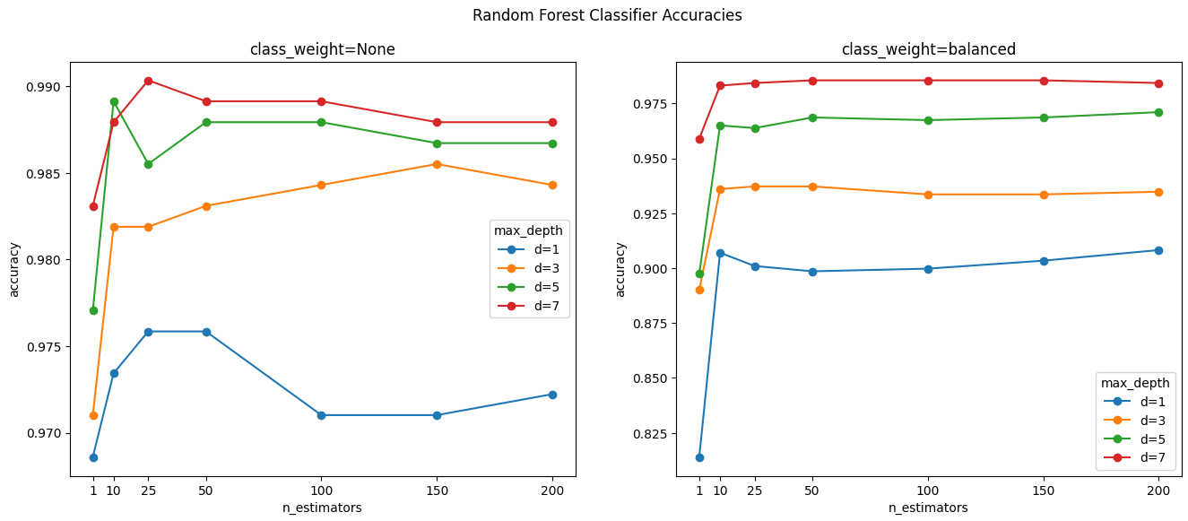
Random Forest Hyperparameter Tuning (1/2)

Slide 9
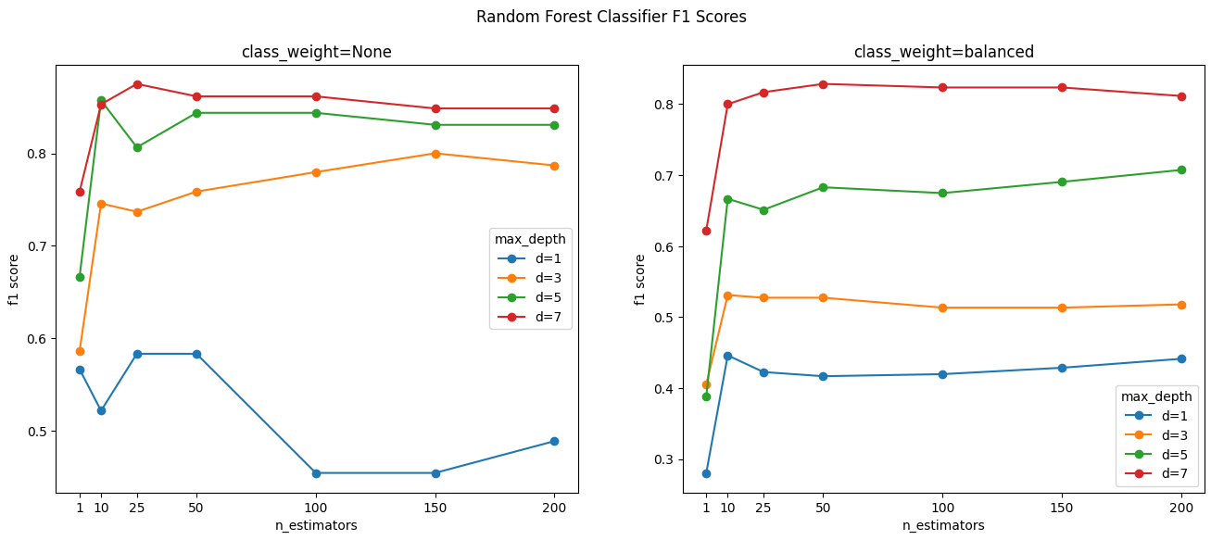
Random Forest Hyperparameter Tuning (2/2)

Slide 10
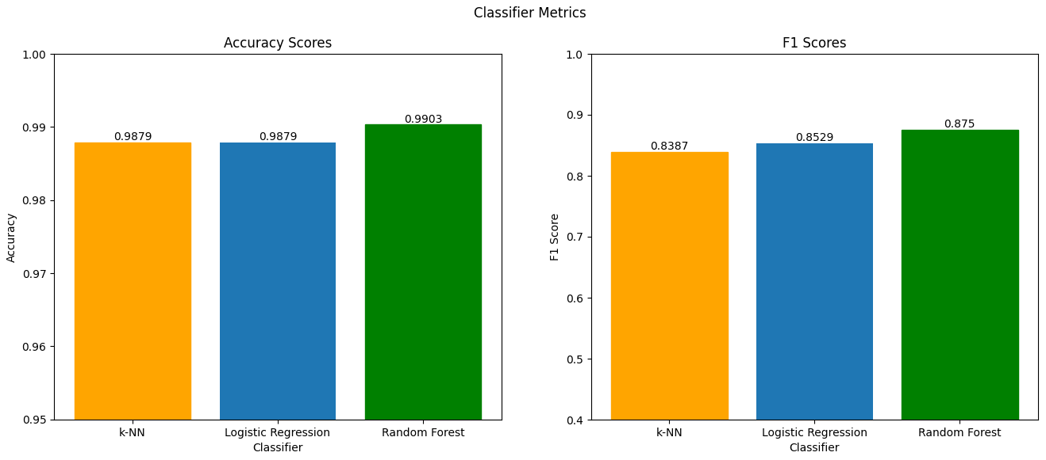
Model Comparison
1st - Random Forest
2nd - Logistic Regression
3rd - k-NN

Slide 11
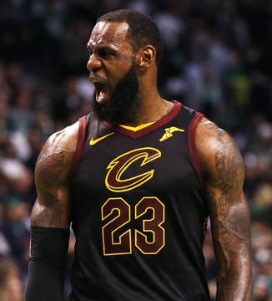
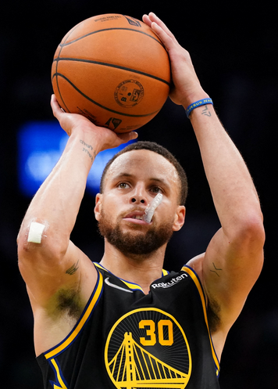
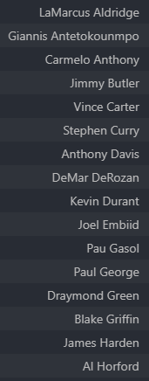
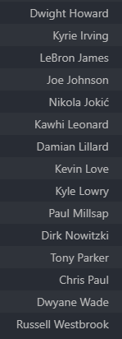
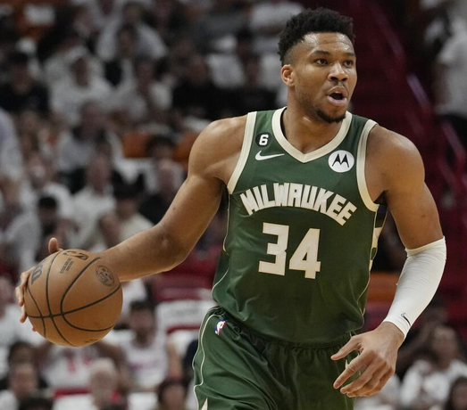
Future Hall of Famers
Which current players will eventually be Hall of Famers?

